Slide 1
Crafting a Solid “Plan for Improvement”

Slide 2
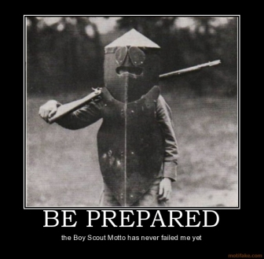
Plan For Improvement
6 P’s
  Proper Prior Preparation Prevents Poor Performance

Slide 3
Plan For Improvement cont…
It is critical that you prepare the Plan for Improvement BEFORE the JCES Professional Development Meeting
As the evaluator – we must be able to identify the areas of deficiency with enough knowledge to:
  Identify the needed area of improvement
  Provide expectations (behavior by the employee) for improvement
  Provide resources to the employee to help them improve. (this is not just attending a conference, etc.)
If you designation someone as an authorized evaluator, please review the evaluation PRIOR to the employee meeting to ensure they incorporated all performance for the year
Conduct a progress meeting
Secure signatures

Slide 4
SMART Goals:
S.M.A.R.T. Goals should be used when writing the “Expectations” portion of the Plan for Improvement.
  Specific
  Measurable
  Attainable
  Realistic
  Timely
Using SMART goals will allow you and employee to know exactly what is expected, when to expect it completed, and if it was completed. NO GUESSING.

Slide 5
Corrective Discipline Procedures
MISCONDUCT

Slide 6
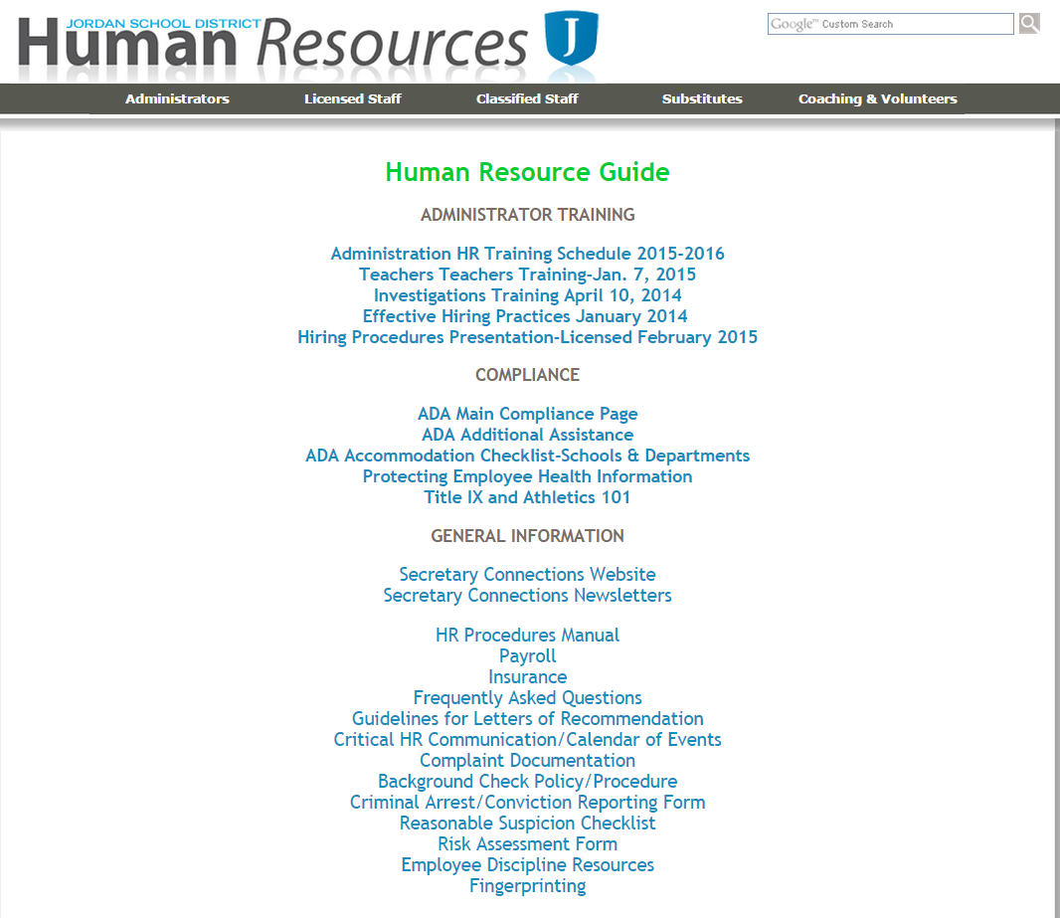
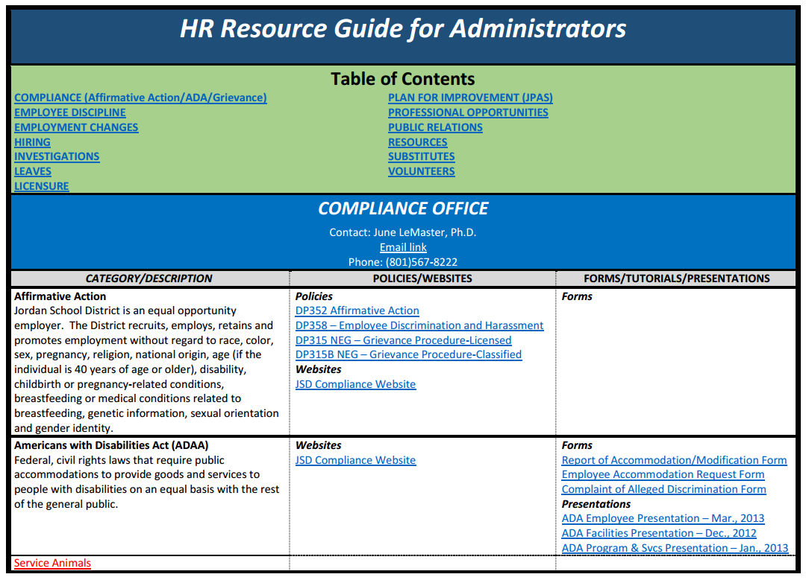
Employee Misconduct cont…
AdminOnly

Slide 7
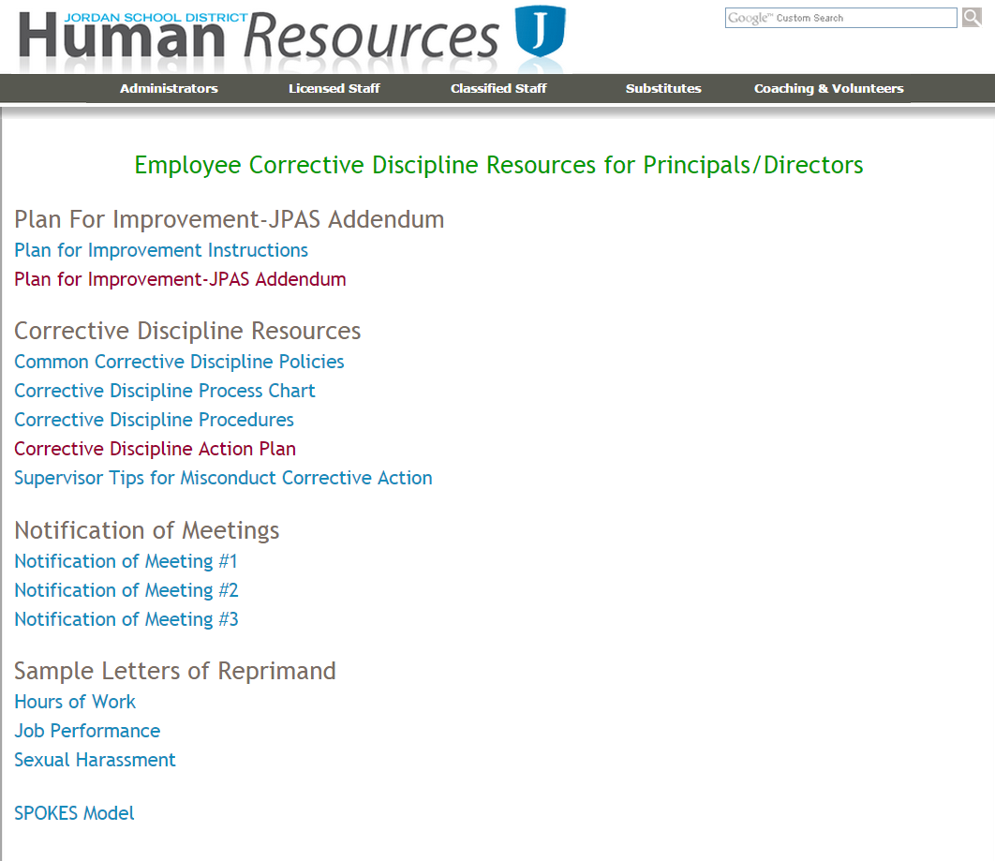
OR
AdminOnly

Slide 8
Corrective Discipline cont…
Always
  Contact your immediate supervisor
  Follow District Policy
  Involve others
  Act in the best interest of Students/District
  Remove yourself emotionally
  Make cognitive decisions NOT based on emotion
  Follow through
  Get signatures
Avoid
  Emotional responses
  Acting in isolation
  Ignoring misconduct
  Accepting responsibility for the employees misconduct
  Statements that corner you or that cannot be supported
  Blame game
  Allowing the employee to “Shift the Monkey”

Slide 9
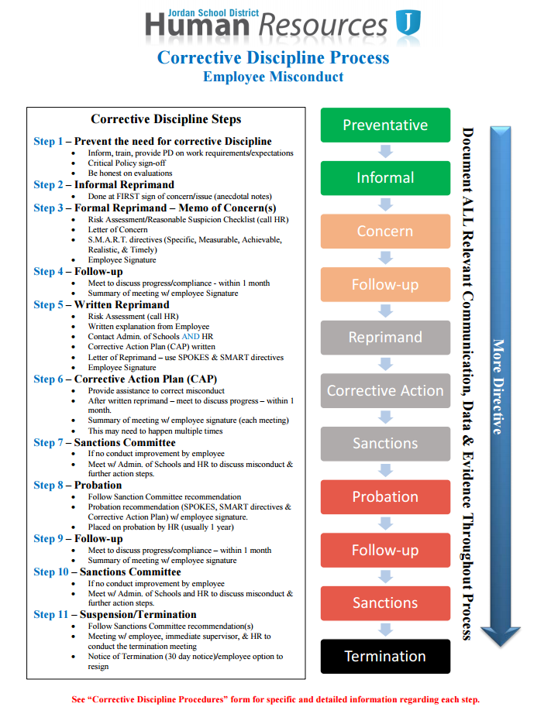
Employee Misconduct cont…
Corrective Discipline Process
The steps of corrective discipline summarized
Allows you to see the entire process at a glance
It is important to note that:
  Not ALL situations will include all of these steps.
  Each step is intended to be the last step required – the intent is to help the employee extinguish the misconduct.

Slide 10
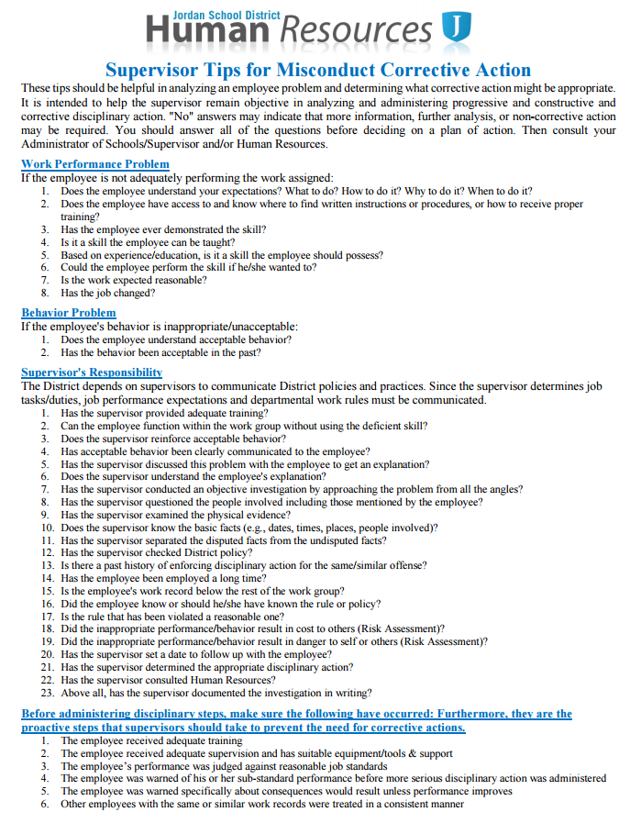
Employee Misconduct cont…
Supervisor Tips for Misconduct Corrective Action
Intended to help you ask questions to clarify the situation
Should help remove the “emotion” and consider the situation “cognitively”

Slide 11
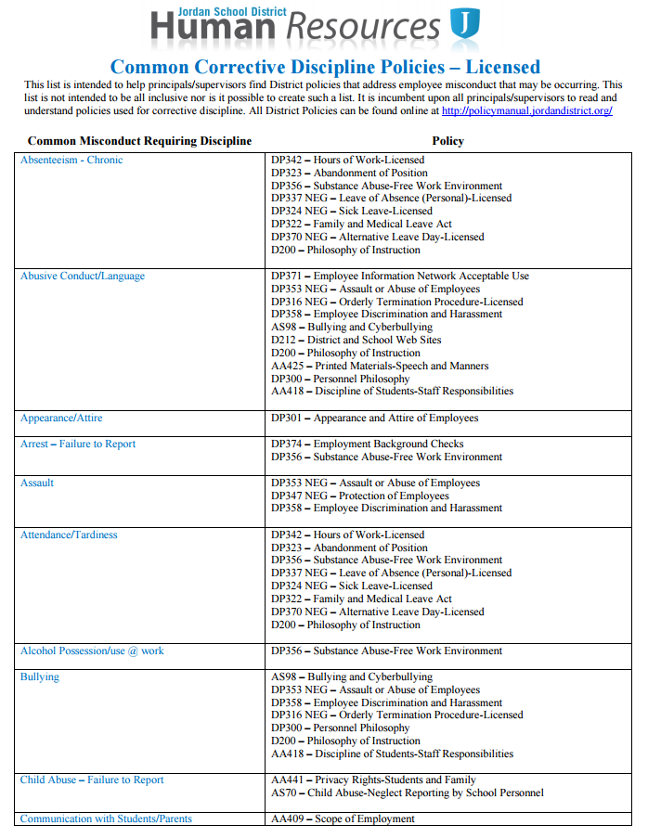
Employee Misconduct cont…
Common Corrective Discipline Policies – Licensed
Resource to match the misconduct with an existing District Policy

Slide 12
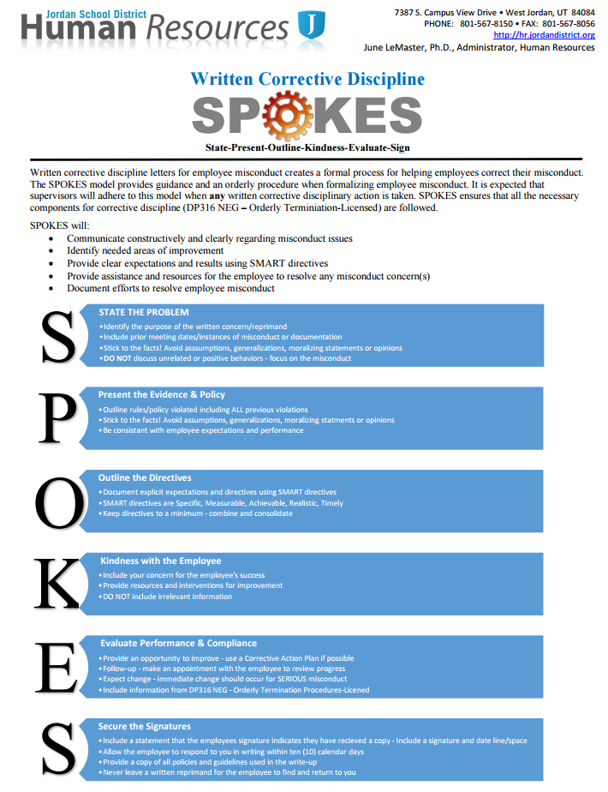
Employee Misconduct cont…
SPOKES
Use for EVERY written corrective discipline letter/memo
Ensures you include what is necessary
Ensures you DON’T include unnecessary things
S.M.A.R.T. Directives are KEY to moving to the next step

Slide 13
SMART Goals are:
Specific
Measurable
Attainable
Realistic
Timely
Using SMART goals will allow you and employee to know exactly what is expected, when to expect it completed, and if it was completed. NO GUESSING.

Slide 14
There is ALWAYS help
Human Resources
June LeMaster
  Human Resource Administrator
Brent Burge
  Human Resource Administrator-Classified
Travis Hamblin
  Human Resource Administrator-Licensed

